Slide 1
Unit 3
The seven traditional tools of quality
New management tools
Six sigma: Concepts, Methodology, applications to manufacturing, service sector including IT
- Bench marking - Reason to bench mark, Bench marking process
- FMEA - Stages, Types .

Slide 2
7 Basic/Traditional Quality Tools
The seven quality tools were originally developed by Japanese professor of engineering Kaoru Ishikawa. They were implemented by Japan’s industrial training program during the country’s postwar period as it turned to statistical quality control as a means of quality assurance. Their goal was to implement basic, user-friendly tools that workers from various backgrounds with varied skill sets could implement without extensive training.
Today, these quality management tools are still considered the gold standard for troubleshooting a variety of quality issues. They’re frequently implemented in conjunction with today’s most widely used process improvement methodologies, including various phases of Six Sigma, TQM, continuous improvement processes, and Lean management.

Slide 3
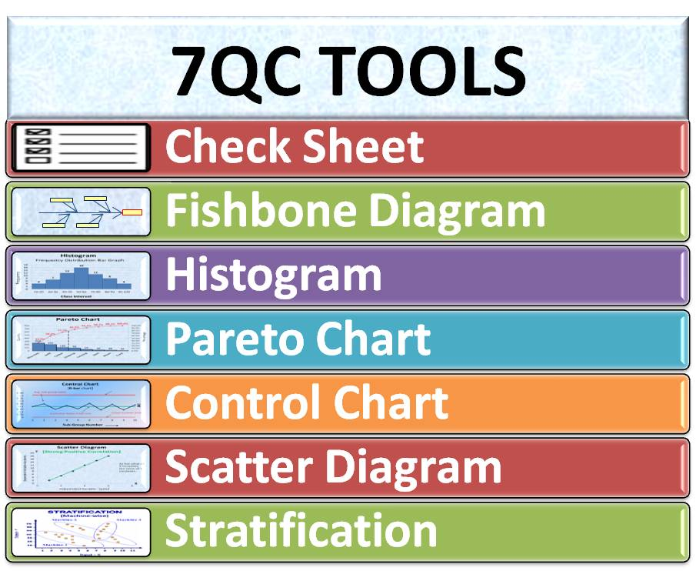
7 Basic/Traditional Quality Tools

Slide 4
Check sheet (or tally sheet)
Check sheets can be used to collect quantitative or qualitative data. When used to collect quantitative data, they can be called a tally sheet. A check sheet collects data in the form of check or tally marks that indicate how many times a particular value has occurred, allowing you to quickly zero in on defects or errors within your process or product, defect patterns, and even causes of specific defects.
With its simple setup and easy-to-read graphics, check sheets make it easy to record preliminary frequency distribution data when measuring out processes. This particular graphic can be used as a preliminary data collection tool when creating histograms, bar graphs, and other quality tools.
Note for students: Do exercise/Practical on attached excel sheet

Slide 5
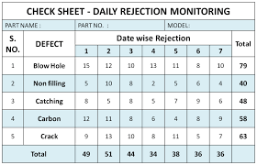
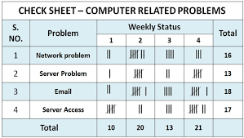
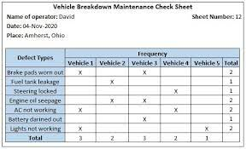

Slide 6
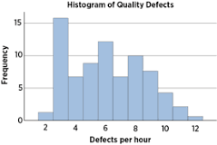
Histogram
Quality professionals are often tasked with analyzing and interpreting the behavior of different groups of data in an effort to manage quality. This is where quality control tools like the histogram come into play.
The histogram can help you represent frequency distribution of data clearly and concisely amongst different groups of a sample, allowing you to quickly and easily identify areas of improvement within your processes. With a structure similar to a bar graph, each bar within a histogram represents a group, while the height of the bar represents the frequency of data within that group.
Histograms are particularly helpful when breaking down the frequency of your data into categories such as age, days of the week, physical measurements, or any other category that can be listed in chronological or numerical order.

Slide 7
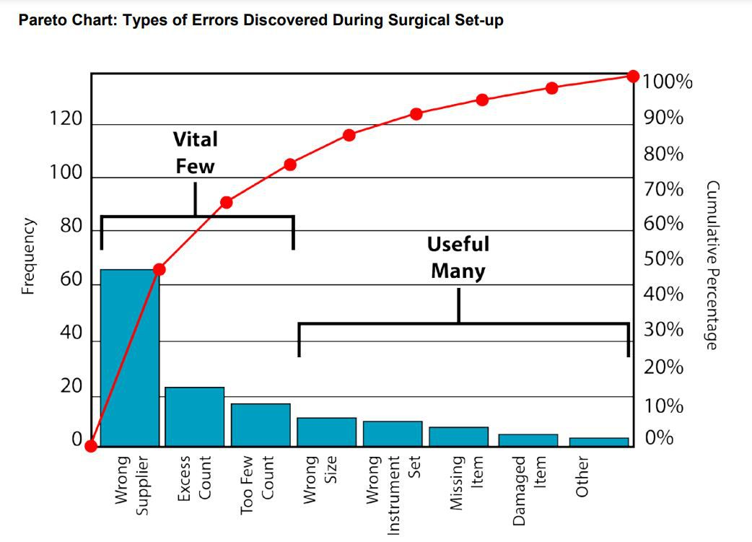
Pareto chart (80-20 rule)
As a quality control tool, the Pareto chart operates according to the 80-20 rule. This rule assumes that in any process, 80% of a process’s or system’s problems are caused by 20% of major factors, often referred to as the “vital few.” The remaining 20% of problems are caused by 80% of minor factors referred to as the “Useful many” .
A combination of a bar and line graph, the Pareto chart depicts individual values in descending order using bars, while the cumulative total is represented by the line.
The goal of the Pareto chart is to highlight the relative importance of a variety of parameters, allowing you to identify and focus your efforts on the factors with the biggest impact on a specific part of a process or system.

Slide 8
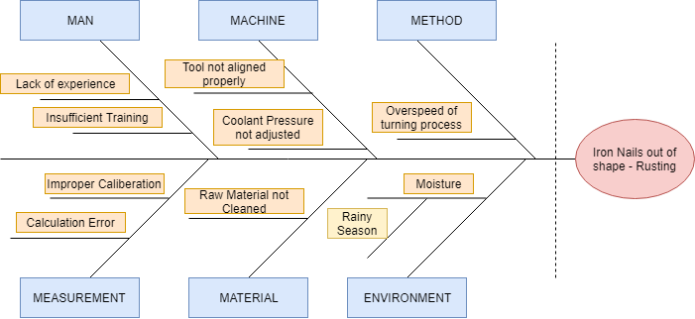
Cause-and-effect diagram (also known as a fishbone or Ishikawa diagram)
Introduced by Kaoru Ishikawa, the fishbone diagram helps users identify the various factors (or causes) leading to an effect, usually depicted as a problem to be solved. Named for its resemblance to a fishbone, this quality management tool works by defining a quality-related problem on the right-hand side of the diagram, with individual root causes and sub causes branching off to its left.
A fishbone diagram’s causes and subcauses are usually grouped into six main groups, including measurements, materials, personnel, environment, methods, and machines. These categories can help you identify the probable source of your problem while keeping your diagram structured and orderly.

Slide 9
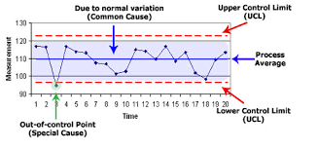
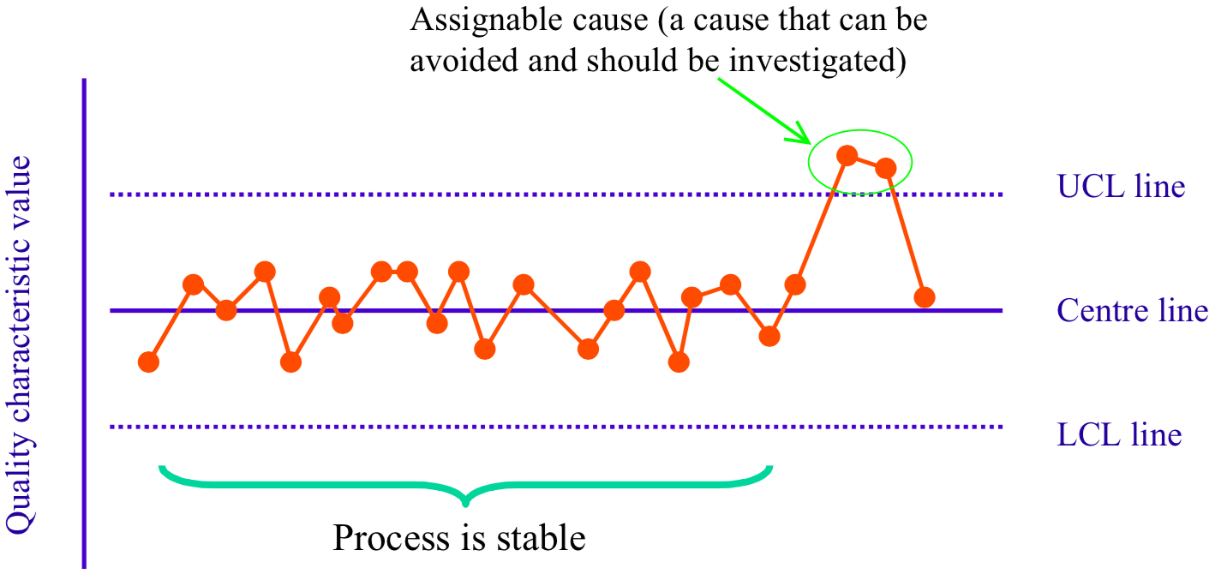
Control chart (also called a Shewhart chart)
Named after Walter A. Shewhart, this quality improvement tool can help quality assurance professionals determine whether or not a process is stable and predictable, making it easy for you to identify factors that might lead to variations or defects.
Control charts use a central line to depict an average or mean, as well as an upper and lower line to depict upper and lower control limits based on historical data. By comparing historical data to data collected from your current process, you can determine whether your current process is controlled or affected by specific variations.
Using a control chart can save your organization time and money by predicting process performance, particularly in terms of what your customer or organization expects in your final product.

Slide 10
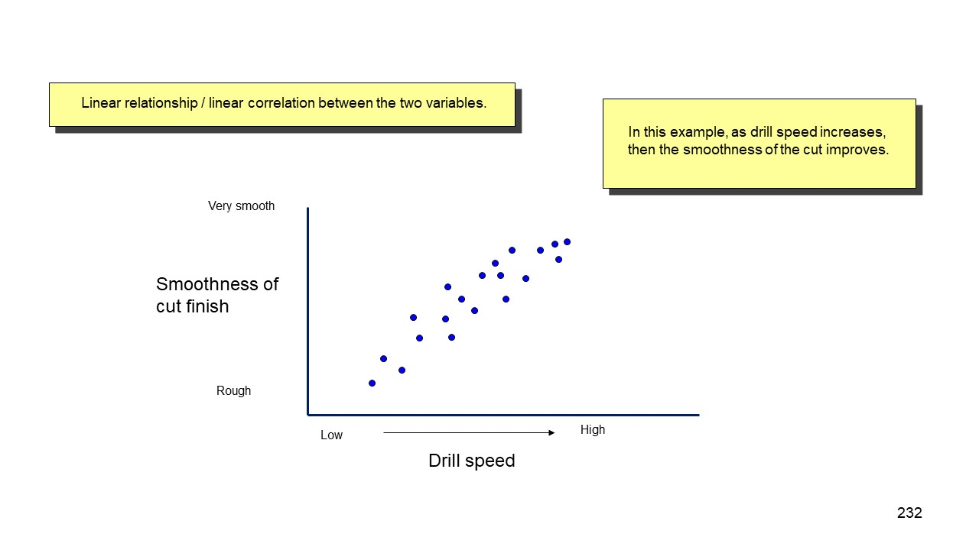
Scatter diagram
Out of the seven quality tools, the scatter diagram is most useful in depicting the relationship between two variables, which is ideal for quality assurance professionals trying to identify cause and effect relationships.
With dependent values on the diagram’s Y-axis and independent values on the X-axis, each dot represents a common intersection point. When joined, these dots can highlight the relationship between the two variables. The stronger the correlation in your diagram, the stronger the relationship between variables.
Scatter diagrams can prove useful as a quality control tool when used to define relationships between quality defects and possible causes such as environment, activity, personnel, and other variables. Once the relationship between a particular defect and its cause has been established, you can implement focused solutions with (hopefully) better outcomes.

Slide 11
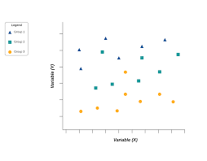
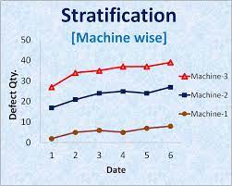
Stratification
Stratification analysis is a quality assurance tool used to sort data, objects, and people into separate and distinct groups. Separating your data using stratification can help you determine its meaning, revealing patterns that might not otherwise be visible when it’s been lumped together.
Whether you’re looking at equipment, products, shifts, materials, or even days of the week, stratification analysis lets you make sense of your data before, during, and after its collection.
To get the most out of the stratification process, consider which information about your data’s sources may affect the end results of your data analysis. Make sure to set up your data collection so that that information is included.

Slide 12
7 New Management and Planning Tools/ Quality control tools
Japanese professor Kaoru Ishikawa originally developed the seven quality tools. These quality tools were simple to use and can be applied by anyone in the organization to improve a process. Later, these seven new quality tools were used to plan the quality improvement process. These tools are called the seven advanced quality tools or seven management and planning tools. These include:
1. Affinity diagrams
2. Tree diagrams
3. Process decision program charts (PDPC)
4. Matrix diagrams
5. Interrelationship digraphs
6. Prioritization matrices
7. Activity network diagrams

Slide 13
1. Affinity diagrams
An affinity diagram is used along with the brainstorming. It is used to organize large amounts of poorly organized or unorganized data into groups that reflect natural relationships. This tool can help you identify patterns in the data.
Created in in 1960’s by Japanese anthropologist Jiro Kawakita, the Affinity Diagram is a method that organizes a large number of ideas into logical and related groupings.
How to use-
The most efficient methodology is to utilize a large work surface (wall or whiteboard), sticky notes, and markers.
Each separate Idea is recorded on a separate note, and all notes are spread out randomly so that everyone can see each note.
During the next step the team should remain silent, sorting the ideas out into groups (with no category headings). 5-10 is the standard number of groupings but this is dependent upon the complexity of the situation. The team should continue to move the items around (writing multiple notes if it seems they fit into more than one group) until the team has grouped all notes. It is Ok to have “loners” that do not fit any particular group, or for a note to be moved once it has been placed.
The Team can begin discussion at this point- The shape of the chart, surprising patterns, and why notes were moved between different groups by different people. Some more changes can be made here, and when the groupings are finalized, select a heading for each group.
Combine groups into Supergroups if the project complexity warrants (Tague, 2005) (ASQ, n.d.).

Slide 14
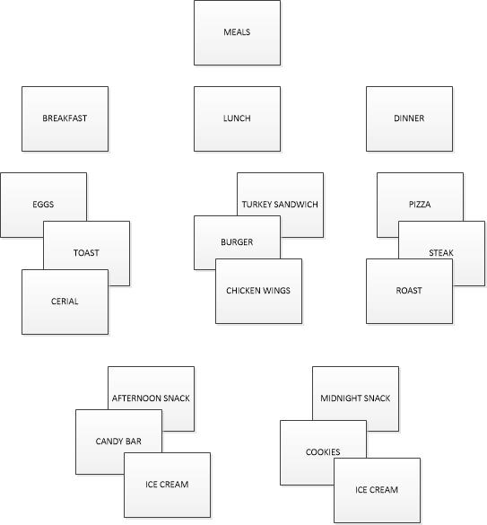

Slide 15
2. Tree Diagrams
A tree diagram is usually used to break down complex concepts or broad categories into smaller parts, making them easier to understand. A tree diagram shows a hierarchical structure of ideas. It helps organize information into categories.
How to use-
Develop statement for goal, project, plan, problem, or issue that is being studied.
Ask a question to help determine the next level of detail, such as
How can this process be completed in the most efficient way?
Why did this occur?
What are the pieces of the whole?
Brainstorm all possible answers (works best with cross-functional team). If other tools have provided information, utilize them.
Tree can be horizontal or vertical. Write each tier of idea in a line and connect it with the idea above it. Show links between tiers with lines/arrows. Confirm all items in a tier are needed for the tier above it, determine that all items in the tier would be sufficient.
Every new Tier becomes the next “goal tier” and continue until the tier has reached the fundamental elements, and the contents of the diagram can be logically confirmed as needed and sufficient from objective to fundamental elements (Tague, 2005) (ASQ, n.d.).

Slide 16
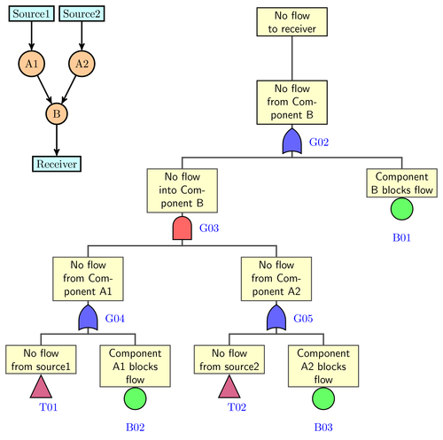

Slide 17
3. Process Decision Program Chart (PDPC)
PDPC is used to identify what may go wrong in a new plan. This tool is somewhat similar to FMEA. You start with a tree diagram to break down the objective into tasks. Draw the next level as what could go wrong, and at the end, the countermeasures to address issues.
Then draw another layer above it to show how things get to the root cause. The PDPC helps you determine where the problems lie and why they occur. It also enables you to determine if an issue has been identified correctly.
How to use details-
Develop a high-level tree diagram of the plan or process using at least three levels and one main objective at the top of the tree
Brainstorm all that could go wrong at current lowest level
Review the problems, and as a team eliminate the highly unlikely items or those with minimal impact to the plan/process. Create a new lower level from these remaining problems linked to the tasks
For each problem brainstorm countermeasures and prepare contingencies for the plan/process problems. Countermeasures are recorded on the next level.
Decide upon practicality of countermeasures using criteria like cost, time, ease of implementations, and effectiveness. Mark the impractical countermeasures with an X and the practical with an O (Tague, 2005) (ASQ, n.d.).

Slide 18
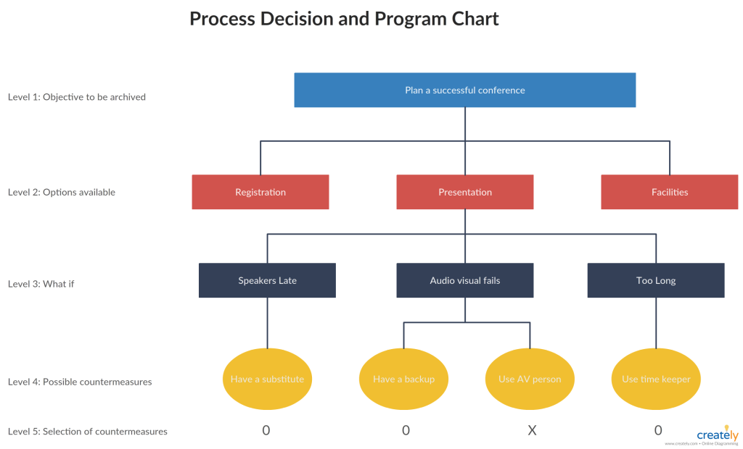

Slide 19
4. Matrix Diagram
A matrix diagram is a tool that helps you to analyze your data. This tool allows you to compare two or more sets of information. It gives visual representations of comparisons between different parameters, such as costs vs. benefits.
The types of matrices include: L- shaped, T–shaped, Y-shaped, X-shaped, C–shaped, and Roof shaped matrices.
An L-Matrix relates two groups of items to each other (or one group to itself)
A T-Matrix relates three groups- A relates to B, A relates to C, but B does not relate to C
A Y-Matrix relates three groups with each group related to the other two circularly: A to B, B to C, C to A
A C-Matrix relates three groups simultaneously
An X-Matrix relates four groups of items, with each group related to two others circularly A to B to C to D to A, but not A to C or B to D
A roof-shaped Matrix relates one group to itself, usually used with an L- or T-Matrix
How to use-
Isolate groups to be compared
Choose the appropriate matrix format
Create Grid
use row labels and column headings for item groups
Determine what information needs to be displayed with the symbols on the matrix. Create a legend (strong/weak/moderate for example)
Compare groups item by item, marking appropriate symbol at the matrix intersection of paired items
Analyze Matrix for patterns and repeat as desired with a different format to learn more (Tague, 2005) (ASQ, n.d.).

Slide 20
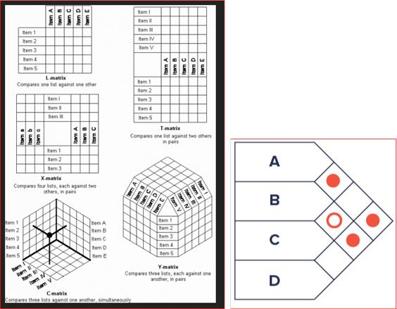

Slide 21
5. Interrelationship Digraph or Interrelationship Diagram
The original term was Relations Diagram, also called: Interrelationship diagram, Interrelationship digraph, network diagram, or matrix relations diagram.
The interrelationship digraph is a graphical representation of the interdependencies among activities. It shows the dependencies between the activities.
An interrelation­ship graph shows the cause-and-effect relationship among various factors involved in an issue. It helps analysts understand why certain things happen.
This is used as a follow up step to an Affinity Diagram, C&E diagram, or Tree Diagram to more thoroughly explore relationships

Slide 22
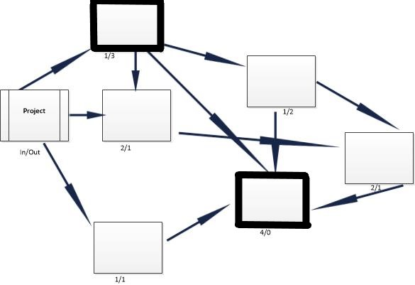
How to use-
Gather these basic materials: Sticky notes, large paper surface, markers, and tape.
Define the issue to explore on a sticky note and place it at the top of the work surface
Brainstorm ideas about the issue and write them on notes. If another tool was used, then obtain ideas from the affinity diagram, lowest level of the tree, or final branches of the fishbone diagram.
Place one idea at a time on the work surface and determine if the idea is related to any others. Place new ideas near related ideas leaving room for drawing of arrows later. Repeat until all ideas have been transferred to work surface. Determine how each idea causes/influences other ideas. Draw arrows from each idea to the ones it causes or influences.
Analyze the diagram
Count the Arrows in and out for each idea and record at the bottom of each box. The ones with the most arrows are the key ideas.
Note which ides have mostly outgoing arrows- These are basic causes.
Note which ideas have mostly incoming arrows- These are final effects that may be critical to deal with.
Double check that some ideas with fewer arrows may be key as well. (the number of arrows is just an indicator) Draw bold lines around key ideas (Tague, 2005) (ASQ, n.d.).

Slide 23
6. Prioritizing Matrices
The Prioritization Matrix is a L-Shaped matrix that compares a list of options/needs to a set of criteria, in order to help choose the best options when too many options are available, or to set the options in order of priority. This is an extremely rigorous method and can be quite time consuming when performed properly as a cross-functional group.
How to Use-
Determine your criteria and rating scale.
Establish criteria weight.
Create the matrix.
Work as a team to score options based upon weighted criteria.
Discuss results and prioritize your list (Tague, 2005) (ASQ, n.d.).

Slide 24
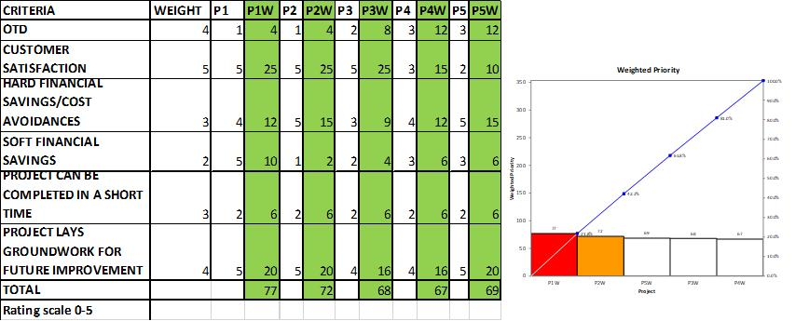

Slide 25
7. Activity Network Diagram (also known as Arrow Diagram)
The Arrow Diagram is a very powerful project planning tool. The Arrow Diagram has evolved over time and as project management has become more prominent. Some of the terms used to describe an arrow diagram are: Activity Network Diagram, Network Diagram, Activity Chart, node diagram, CPM -Critical Path Method- Chart, and PERT -Program Evaluation and Review Technique- chart.
An activity network diagram is a tool that visualizes all the activities involved in a particular project. It represents the relationships between the different activities. Each box represents an activity, and the arrows represent the flow.
Activity Network Diagrams manage a number of tasks in a sequence and identify bottlenecks or the critical path in the project execution.
Summary
These seven management and planning tools help us explore our data and make better decisions. We use them to visualize, sort, group and analyze our data. They provide some insights into whether we need to change our planning process. They help us identify the most critical areas to focus on.

Slide 26
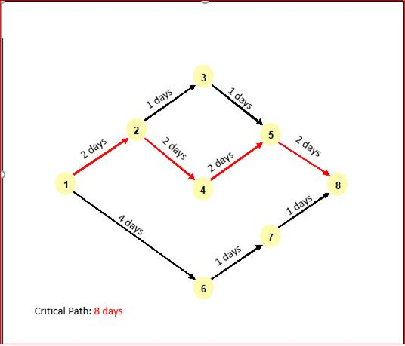
How to use-
Write out all tasks in the project or process on a sticky note, placing and arrow under the project task pointing to the right.
Sequence the tasks.
Which tasks must happen before the previous one can begin?
Which tasks can be done at the same time?
Which tasks should happen immediately after each task?
Diagram the network of tasks. Arrange them in sequence on a large piece of paper. Time should flow from left to right and concurrent tasks should be vertically aligned. Leave space between the notes.
Between each two tasks, draw circles for “events.” An event marks the beginning or end of a task and can help visually separate tasks.
When the network is correct, label all events in sequence with event numbers in the circles.
Determine task times—the best estimate of the time that each task should require. Use one measuring unit (hours, days, or weeks) throughout, for consistency. Write the time on each task’s arrow.
Determine the critical path (the longest path) from the beginning to the end of the project by summing all of the potential paths from beginning to end of project. Mark the critical path with a heavy line or color. (Tague, 2005) (ASQ, n.d.)

Slide 27
Six sigma: Concepts, Methodology, applications to manufacturing, service sector including IT
Refer to below Video Links for Basics of six sigma
https://www.youtube.com/watch?v=4EDYfSl-fmc&t=109s -9min
https://www.youtube.com/watch?v=4oJhV0al6HQ&t=5s (start at 8:30)—40 min
Ref1: https://www.simplilearn.com/what-is-six-sigma-a-complete-overview-article
Ref2: https://www.simplilearn.com/six-sigma-role-manufacturing-industry-rar406-article

Slide 28
DMAIC & DMADV
Six Sigma prescribes an improvement process known as DMAIC (Define—Measure—Analyze—Improve—Control). However, its application is limited to improving existing processes. It doesn’t address the design of new products, services, or processes.
For developing a new product, service or process, there’s a modified version called DFSS (Design for Six Sigma). The process most often used in DFSS is called DMADV (Define—Measure—Analyze—Design—Verify).

Slide 29
DMAIC (Define—Measure—Analyze—Improve—Control)
DMAIC is the more well-known and most-used LSS project method. DMAIC focuses on improving an existing process by incorporating the following phases:
Define | Define the problem, output to be improved, customers, and process associated with the problem.
Measure | Collect data from the process to establish a baseline for the improvements.
Analyze | Analyze the data to find the root causes of defects.
Improve | Develop, test, and implement solutions to improve the process.
Control | Implement process controls to sustain the improvements.
DMADV (Define—Measure—Analyze—Design—Verify)
DMADV is focused on the process of designing a new product, service or process, incorporating the following phases:
Define | Define the process and design goals.
Measure | Measure and identify critical-to-quality characteristics of the product, service or process. This includes risk and production capabilities.
Analyze | Analyze the data to find the best design.
Design | Design and test the product, service or process.
Verify | Ensure that the design output meets the design input requirements (verification) and that the designed product performs satisfactorily under real or simulated conditions of intended use (validation).

Slide 30
Similarities of DMAIC and DMADV
Both DMAIC and DMADV:
Use structured methods to reduce variation and solve problems
Collect and analyze data to make informed decisions
Use teams to solve problems
Have a customer focus
Use many of the same tools (brainstorming, FMEA, DOE)
Differences of DMAIC and DMADV
DMAIC addresses the current process; DMADV addresses the design process.
DMAIC reduces/eliminates defects (reactive); DMADV prevents defects (proactive).
DMAIC includes specific solutions; DMADV is part of the solution design process.
DMAIC includes controls to sustain the gains; DMADV includes verification and validation of the finished design.

Slide 31
Six sigma applications to manufacturing
Six Sigma identifies and removes defect-causing elements. In this methodology, an organization follows a defined set of steps to quantify the targeted value of the project. An application of Six Sigma in manufacturing can help an organization reduce pollution, reduce the time cycle of one or more processes, and reduce the cost of production for increasing profits and satisfaction level of its customers.
Motorola reported some astonishing facts about the benefits Six Sigma had for its organization after registering its service mark: they disclosed they had saved more than $17 billion by the end of 2006 with the help of quality improvement processes offered by this unique system.
General Electric: Despite hiring the best specialized personnel available and using the latest technology, GE has had issues with product quality and overall service. Integrating Six Sigma into all operations helped GE pinpoint previously unnoticed defects that slowed production. GE’s updated strategy streamlined processes and reduced waste.
Boeing Airlines: Six Sigma empowered Boeing Airlines to fix an engine air fan problem. The company discovered manufacturing issues that caused harmful electrical problems.
Some of the other leading brands who have implemented Six Sigma into their processes and achieved success include General Motors, Dell, Kodak, Ford Motors, and 3M.

Slide 32
Six sigma applications to Service Industry including IT
Although Six Sigma started with manufacturing segment, Six Sigma success is not restricted to manufacturers alone. The methodology can be used effectively in the service segment too; and has in fact helped lots of service industries like education, financial services, health care, and many more with equal results.
Six Sigma helps in improving on lots of processes like generating business expansion, improving customer service, and gaining knowledge about service sectors business processes. Six Sigma also helps to improve the processes involved with human resources, marketing, and sales.
The defects are first identified, data is collected as to how the defects occur, and then a new method of working is implemented to reduce errors in the future. This methodology has helped various financial sectors, insurance companies, educational institutes, management companies, state agencies, and high-tech companies to improve their quality.

Slide 33
The white paper “Jet Engines and Sales: How Six Sigma Brings Breakthrough Results to the Service Sector” provides proof that the methodology can benefit any industry.
One financial services firm mentioned in the white paper was concerned over the high amount it paid for customer service. Although they offered customers a web-based platform to contact them – an option that was the least expensive for the company – customers still continued to use the call center to receive their account information.
Wanting to deliver high customer service but in a less expensive way, the
company implemented a Six Sigma project and examined all call center
and website data. It eventually found a way to reconfigure the website
which would decrease cost but elevate the level of customer service. The
result was the movement of customers to the Web, rather than the
phone, to get account information.
Another company, this one a large insurance firm, had a 41 day cycle time for claims, which was almost 3x the amount of days deemed appropriate by customers. Customer satisfaction was at an all-time low. After applying Six Sigma, and in less than five months, the project team assessed the organization’s defect rate and identified key factors involved. They also reduced the defect rate by more than 70% which resulted in increased customer satisfaction and a savings of more than $250,000.

Slide 34
Bench marking - Reason to bench mark, Bench marking process
Benchmarking is measuring key business metrics and comparing them to metrics from internal departments or competitors. Implementing this practice can help a company understand its strengths and weaknesses to optimize internal processes.
Benchmarking is a process to discover what is the best standard of performance seen in a specific company, by a particular competitor or by a completely different industry. The process of benchmarking involves four distinct steps:
1. Identifying the areas where the organization is keen to identify actionable insights. These could range from cost of production to number of critical to quality errors to employee engagement scores.
2. Once the areas have been identified, the organization then shortlists the companies/industries to benchmark.
3. The third step that follows is to collect data from these identified companies/industries across the areas of interest that were zeroed in earlier.
4. Finally, when the data has been collected, the organization studies the gaps between their standard and that of the benchmark.

Slide 35
Types of benchmarking in business
Here are common types of benchmarking in business:
Performance benchmarking: The process of identifying the difference between anticipated and desired results by measuring key performance indicators
Internal benchmarking: The process of comparing data from departments within a single organization
External benchmarking: The process of an organization's data with data from a competitor
Practice benchmarking: The process of collecting qualitative information about a specific business operation
Strategic or competitive benchmarking: A strategy in which a business attempts to emulate specific standards of world-class organizations

Slide 36
Reasons to benchmark/ Advantages
1. Increase efficiency
Performing regular benchmarks contributes to a company's overall effectiveness and efficiency by allowing it to identify potential areas of improvement internally
2. Set clear business goals
Performing regular benchmarks can allow you to set clearer business goals for your employer. Understanding why the competition is successful can also give you insight that may help create measurable goals by defining success, developing innovative strategies and effectively monitoring your progress towards each goal.
3. Provide new opportunities for discovery
Another reason benchmarking in business is important is that it gives you a way to discover opportunities for increased growth and success. This is especially important if your company is stuck or not moving forward the way you want. Performing benchmarks allows you to identify areas for improvement to get the company on par with the growth and success of other businesses in your industry or niche.
4. Increase sales performance
Benchmarking allows you to assess your sales figures and compare them to the most successful businesses in your niche or industry. For example, you could examine how much another company is selling, how many people are on their sales team, how many sales teams they have and whether your competitors are working with other major companies in partnerships.

Slide 37
5. Motivate employees
Regular benchmarking in business also provides a great opportunity to rejuvenate employees and increase their overall motivation and contribution to the organization. The best benchmarking to improve employee motivation is benchmark tests that evaluate the competition's departments. You then compare these results to the departments within your company and set goals to match the competition.
6. Better understand the competition
Understanding competitors methods of operation and what contributes to their overall success will let you expand your current operations and increase overall productivity and performance
7. Improve product quality
You can also use benchmarking to assess your current product quality and improve it. You might analyze how durable a competing product is or measure the customer satisfaction of the competitor's consumer base. From there, you can source the appropriate materials for your items and revise your approach to customer service to increase overall satisfaction.

Slide 38
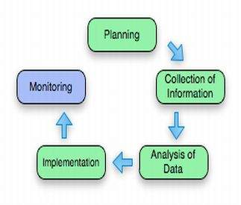
Bench marking process

Slide 39
(1) Planning
Prior to engaging in benchmarking, it is imperative that corporate stakeholders identify the activities that need to be benchmarked.
Prior to engaging in the benchmarking process, the total process flow needs to be given due consideration. For instance, improving one core competency at the disadvantage to another proves to be of little use.
The next step in the planning process would be for the company to choose an appropriate benchmark against which their performance can be measured.
The benchmark can be a single entity or a collective group of companies, which operate at optimal efficiency.
2) Collection of Information
Information can be broadly classified under the sub texts of primary data and secondary data.
Exploratory research, market research, quantitative research, informal conversations, interviews and questionnaires, are still, some of the most popular methods of collecting information. Drafting a questionnaire or a standardized interview format, carrying out primary research via the telephone, e-mail or in face-to-face interviews, making on-site observations, and documenting such data in a systematic manner is vital, if the benchmarking process is to be a success.

Slide 40
(3) Analysis of Data
Once sufficient data is collected, the proper analysis of such information is of foremost importance.
Data analysis, data presentation (preferably in graphical format, for easy reference), results projection, classifying the performance gaps in processes, and identifying the root cause that leads to the creation of such gaps (commonly referred to as enablers), need to be then carried out.
(4) Implementation
This generally means that far-reaching changes need to be made, so that the performance gap between the ideal and the actual is narrowed and eliminated wherever possible.
(5) Monitoring
As with most projects, in order to gain the maximum benefits of the benchmarking process, a systematic evaluation should be carried out on a regular basis.

Slide 41
Failure Mode and Effects Analysis (FMEA)
FMEA or Failure Mode and Effects Analysis is a structured approach to uncover potential failures that may exist or go unseen within the design of a product, service, or process. This methodology aims to enable organizations to anticipate the various point of failure during the design stage itself to eliminate all possible future consequences like delayed completion, excess capital expenditure, etc.
In simple terms, FMEA uses a spreadsheet to help professionals identify and note down all that could go wrong within a product or process using qualitative and systematic methods. It also helps us know the possible causes of failures and detects failure before its occurrence. These characteristics help industries take quick and decisive actions that help mitigate failure while creating a reliable and quality product/process.
Failure modes, here are the different ways in which a process/product can fail. On the other hand, Effects are failures that can lead to defects, waste, or unsafe outcomes for the end customer. Thus Failure Mode and Effects Analysis (FMEA) is designed to identify failure modes, segregate, prioritize, and then limit these failure modes from ever occurring.

Slide 42
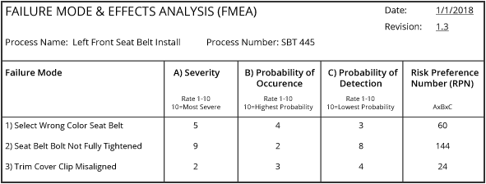
FMEA Example
Here is an example of a simplified FMEA for a seat belt installation process at an automobile assembly plant.
As you can see, three potential failure modes have been identified. Failure mode number two has an RPN of 144, and is therefore the highest priority for process improvement.
Here RPN = (Severity) x (Frequency) x (Detection)

Slide 43
Types of FMEA
There are different types of FMEA. All these types focus on detecting failure modes early on and eliminating them.
Design FMEA
This type of FMEA enables you to identify and address failure modes during the design stage or at the end. It involves breaking down the design into several components and analyzing the potential failure modes.
Process FMEA
This type of FMEA is used in analyzing and maintaining process control objectives. As the name suggests, its performed on processes rather than on products. Like DFMEA, you will break down the process into various components here.
FMECA
It’s known as Failure Mode, Effects, and Criticality Analysis. It brings criticality analysis into the FMEA process.
The other well-known types of FMEA are:
Functional FMEA
Software FMEA
Manufacturing FMEA
Service FMEA, etc.

